Slide 1



IMDB MOVIE ANALYSIS

Slide 2

PROJECT DESCRIPTION
APPROACH
REQUIREMENTS
We are given a dataset having various columns of different IMDB Movies.
Ultimately, we’re going to analyze the dataset of IMDB movies. We have to share our insights by identifying the problems in the dataset. The overall objective of the project is to get a better understanding of the movie industry and how analytics helps in identifying the problem and solutions.
Firstly, we’ll understand the data after getting the insights we’re going to clean it or we will check for the blank values.
After this step we will remove outliers if any and then we will present our results using excel through charts and graphs.
We’re going to find some insights such as “DATA CLEANING”, “ MOVIE WITH HIGHEST PROFIT” , “IMDB TOP 250”, “ BEST DIRECTORS”, “POPULAR GENRE”, “CRITIC FAVOURITE & AUDIENCE FAVOURITE” these insights would help in developing our understanding.
TECH-STACK USED
Ms| Excel 2019

Slide 3

DATA CLEANING

Slide 4
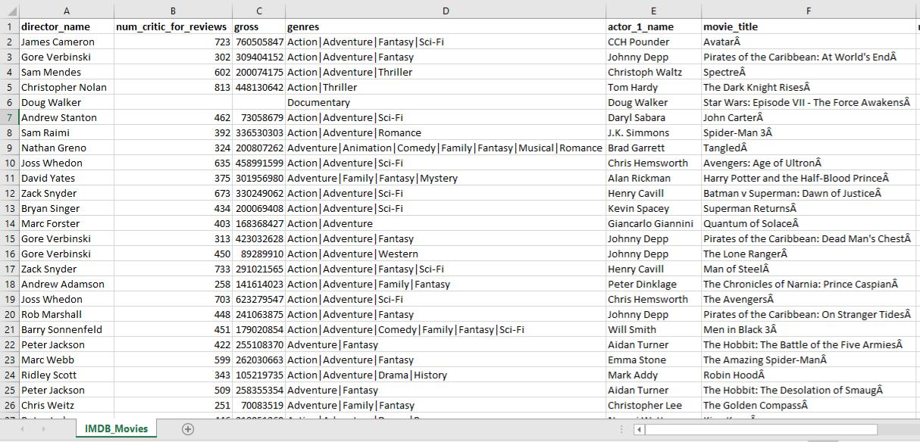
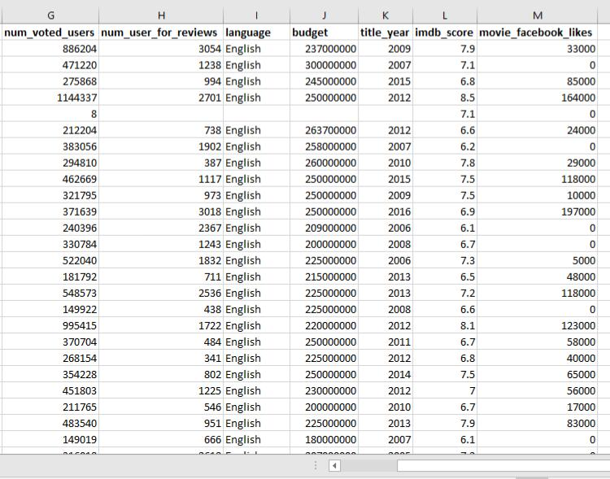
REMOVING UNWANTED
COLUMNS
Data Cleaning is one of the most important step to perform before moving forward with the analysis.
There are 15 columns which are not needed for our analysis so, we removed these columns from our dataset.
After removing unwanted columns there are only 13 columns remaining as shown here.
Before Cleaning After Cleaning
Rows: 5044 5044
Columns: 28 13

Slide 5

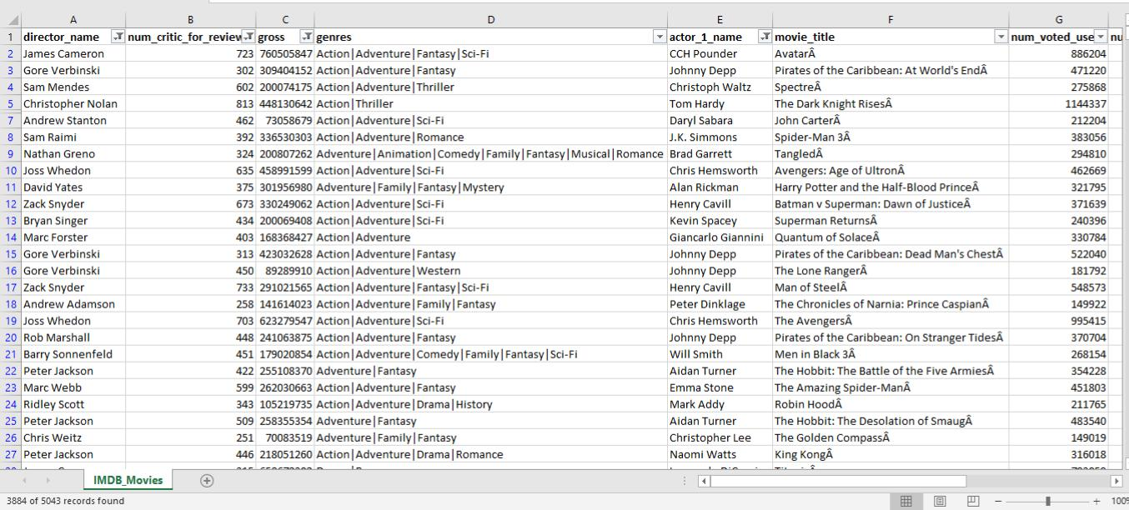
REMOVING BLANK VALUES
Now, it’s time to remove null or blank values from our dataset.
We removed blank values by Using “Filter” function under Data tab.
Before removing After removing
Rows: 5044 3884
Columns: 13 13

Slide 6

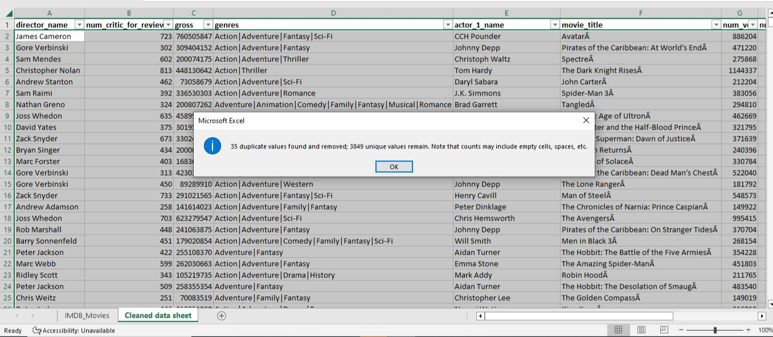
REMOVING DUPLICATES
Now, we’re going to remove duplicates from our dataset (if any)
To remove duplicates we need to click on “Removing duplicates” under Data tab by selecting the entire dataset.
We found 35 duplicates
Before removing After removing
Rows: 3884 3849
Columns: 13 13

Slide 7

MOVIES WITH HIGHEST PROFIT

Slide 8

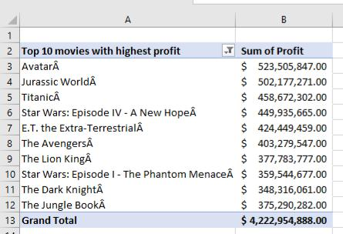
MOVIES WITH HIGHEST PROFIT
For finding movies with highest profit we need to first find out the profit by subtracting Budget from Gross and name that column as “Profit”.
After that we need to sort the profit column from largest to smallest by using “Sort” function. After sorting we created a pivot table using movie_titles column and Profit column.
As shown here we got “Top 10 Highest Profitable Movies” and then we made a Bar chart to represent our outcome.

Slide 9
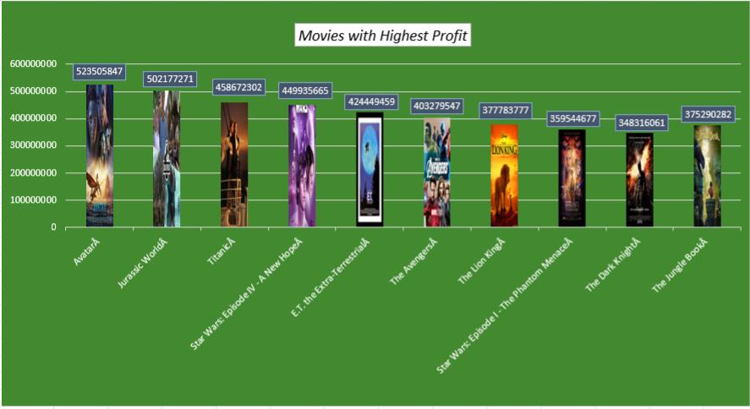

Slide 10
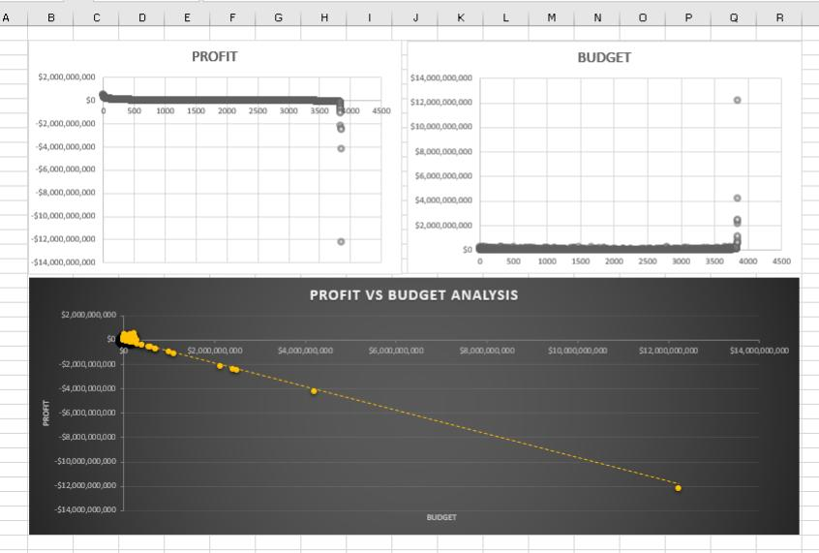
OBSERVING OUTLIERS USING
CHARTS
We observed outliers individually for Profit and Budget and one combined for Profit and Budget together.

Slide 11

IMDB TOP 250

Slide 12
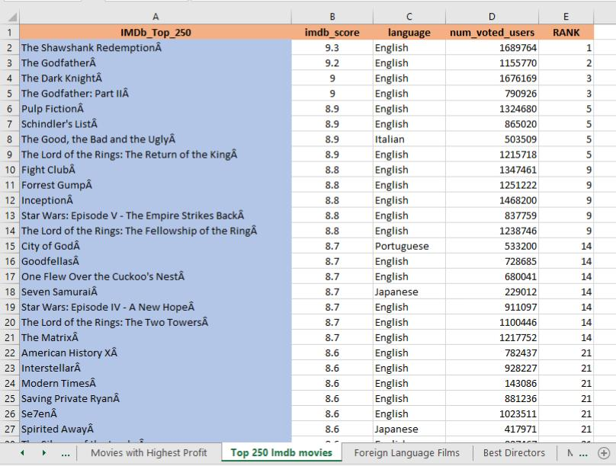
TOP 250 MOVIES
For finding Top_250_movies Firstly, we want only those movies who have no. Of voted users> 25000 so, for this we filtered this column.
After that we sorted movies according to their imdb_score.
As shown here in the table we got Top 250 movies and assigned them ranking according to the imdb_score .

Slide 13
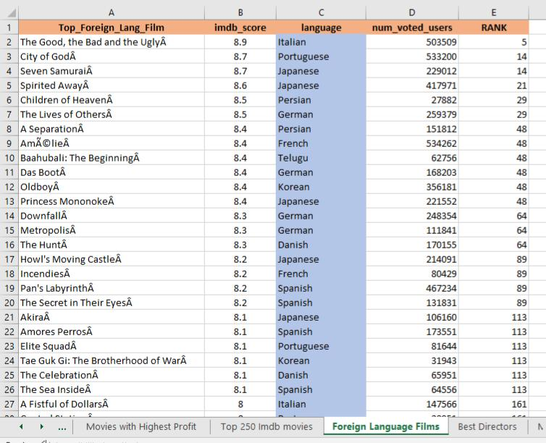
TOP_FOREIGN_LANG_FILM
After Filtering and Sorting we have to extract all those movies which are not in English language.
So, for this we filtered this column and got movies other than English language.
As shown here, next preferred language after English is Italian.

Slide 14

BEST DIRECTORS

Slide 15
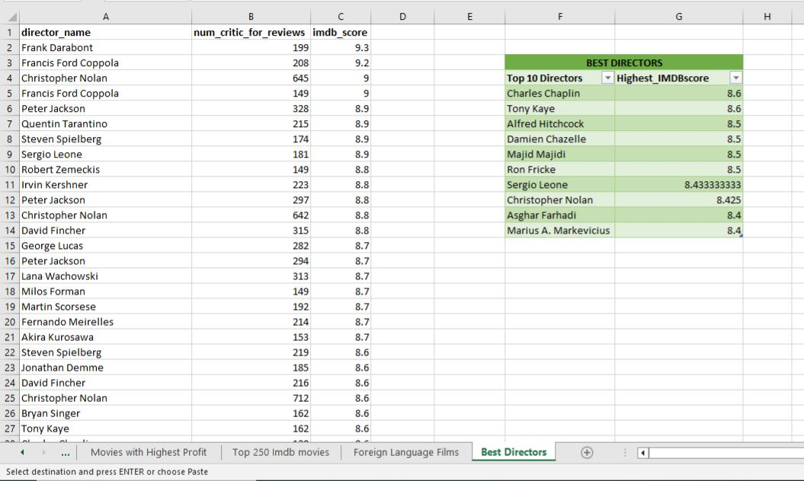
TOP 10 DIRECTORS
We have to find Top 10 Best Directors on the basis of their highest Mean IMDb Score.
Firstly, we removed duplicates from our data and then sorted imdb_score after that we sorted director_name.
After sorting we created a pivot table which shows Top 10 Best Directors.

Slide 16

POPULAR GENRES

Slide 17
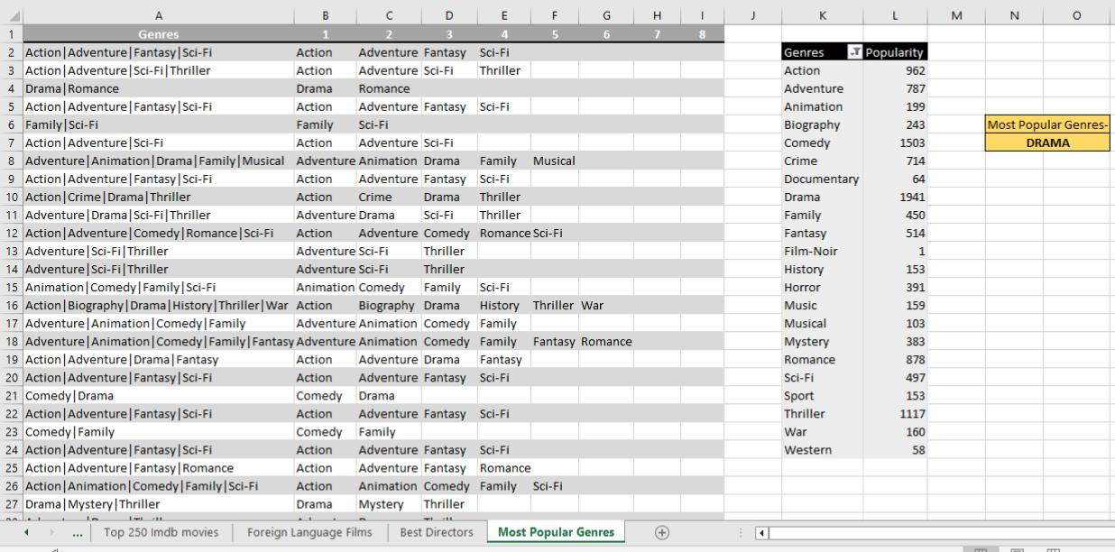
POPULAR GENRES
To find Popular Genres We need to first split the values using Text to column function.
After successfully splitting the values We created a pivot table and count the values.
We got “Drama” as our most popular Genres.

Slide 18


CHARTS

Slide 19
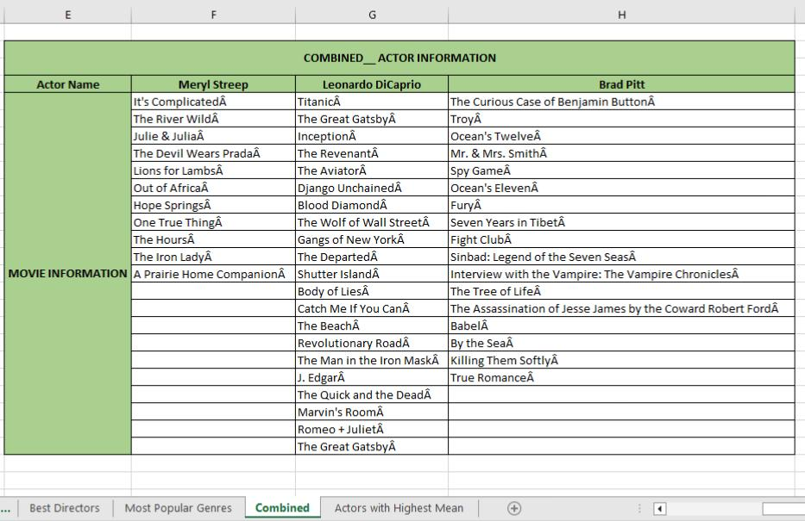
COMBINED ACTOR NAMES
Here, We filtered movies of these three actors named ‘Meryl Streep’, ‘Leonardo DiCaprio’ and ‘Brad Pitt’ where they are the lead actors and then append the rows of all these columns and store them in new column called ‘Combined_Actor Information’.

Slide 20
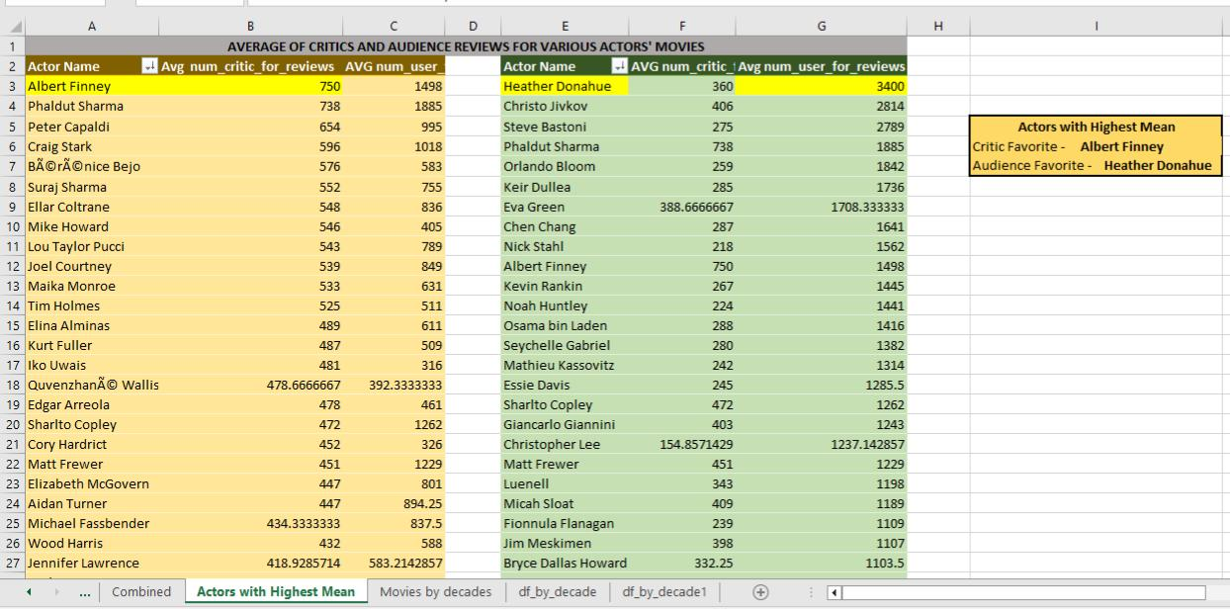
AUDIENCE FAVORITE AND CRITIC FAVORITE ACTORS
We did Mean of num_critic_for_review and num_user_for_reviews .
After that we sorted both and found the favourite actors in both the categories.
Critic favourite actor- Albert Finney
Audience favourite actor- Heather Donahue.

Slide 21
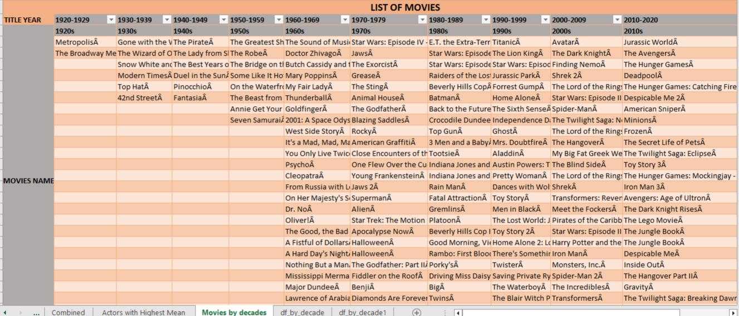
OBSERVE THE CHANGE IN NUMBER OF VOTED USERS OVER
DECADES
For observing changes over decades, we divided the columns as per decades and filtered out the movies that falls under their respective decades.

Slide 22
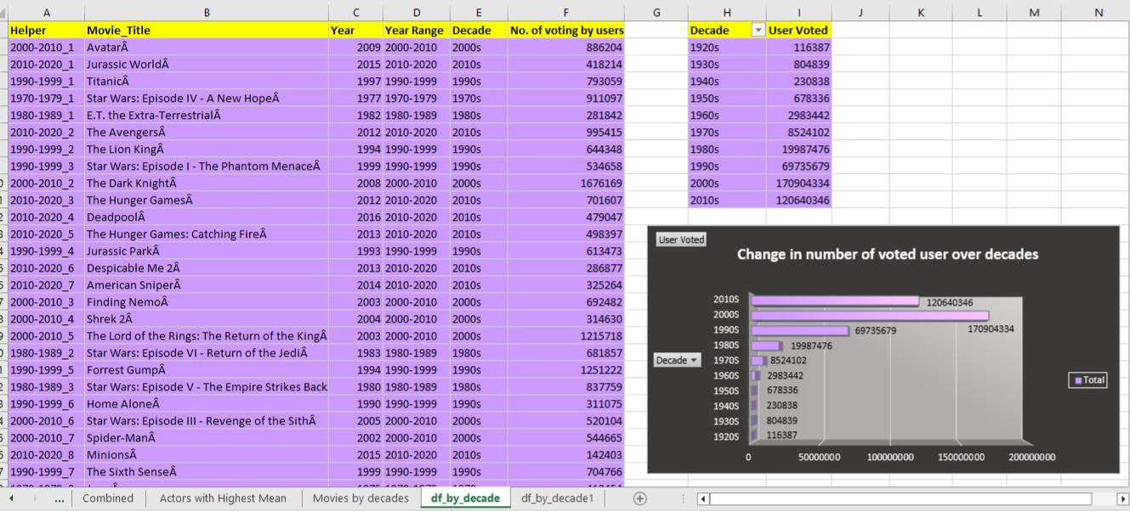
Add column name ‘Helper’ and Using Vlookup function we extracted the data.
After that using pivot table we observed the changes in number of voted users in a graphical form.

Slide 23
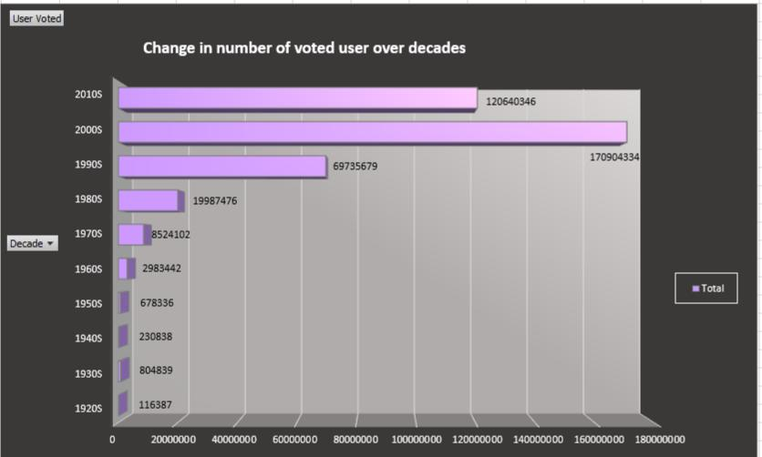

Slide 24

KEY INSIGHTS
• Data Cleaning and removing outliers from the data are the necessary steps before working on any data because it improves the authenticity of the data.
• We got movies with highest profit where the first profitable movie is ‘Avatar^A’.
• Best Director is “Charles Chaplin”.
• Popular Genres is “Drama”.
• Critic favorite Actor- Albert Finney and
Audience favorite actor- Heather Donahue.
• Between Decade 2000-2009 the number of voted users were maximum.

Slide 25


